Slide 1
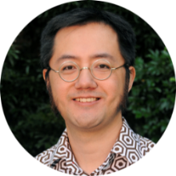
General practitioner follow-up in older patients after an emergency department admission
WATSONBelinda
medical student
PELLIZZONBelinda
TAMMichael
FRF ED NUM
BANLucille
General Practice Unit
michael.tam@sydney.edu.au
+61 412 704 158
FRF ED deputy director
DOANHarry
FRF director, medical services

Slide 2
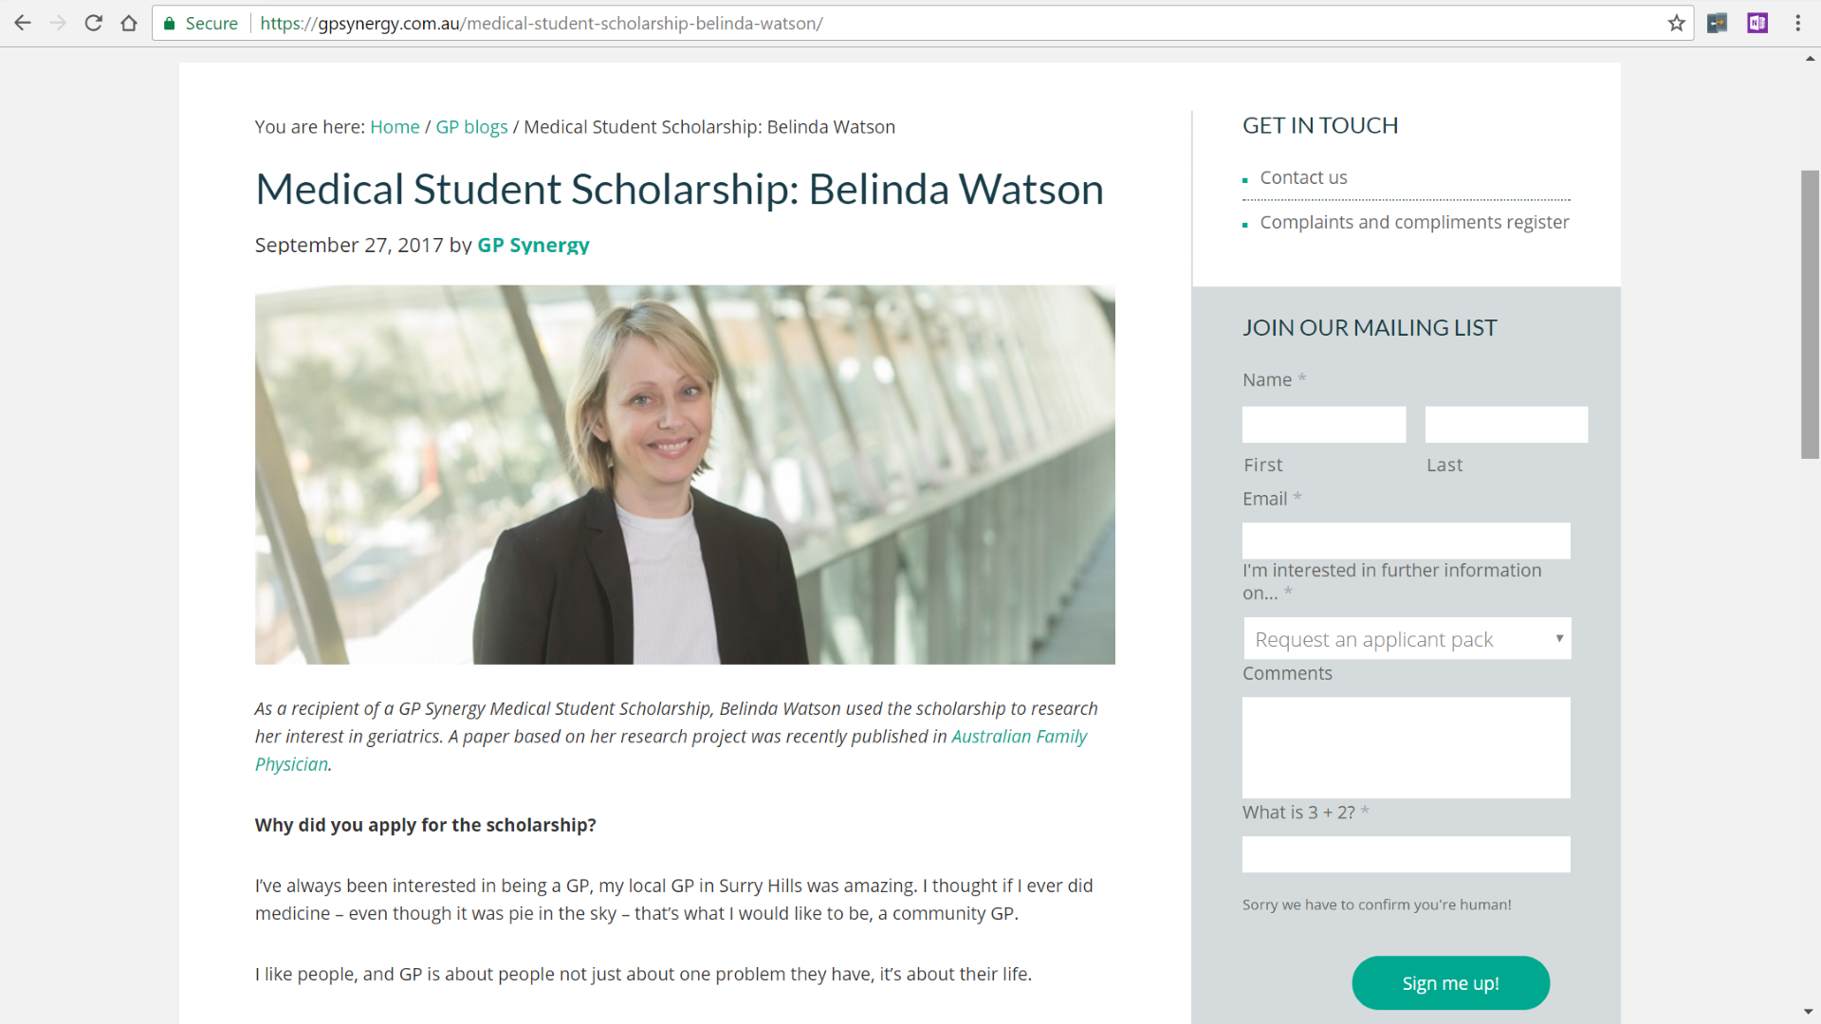
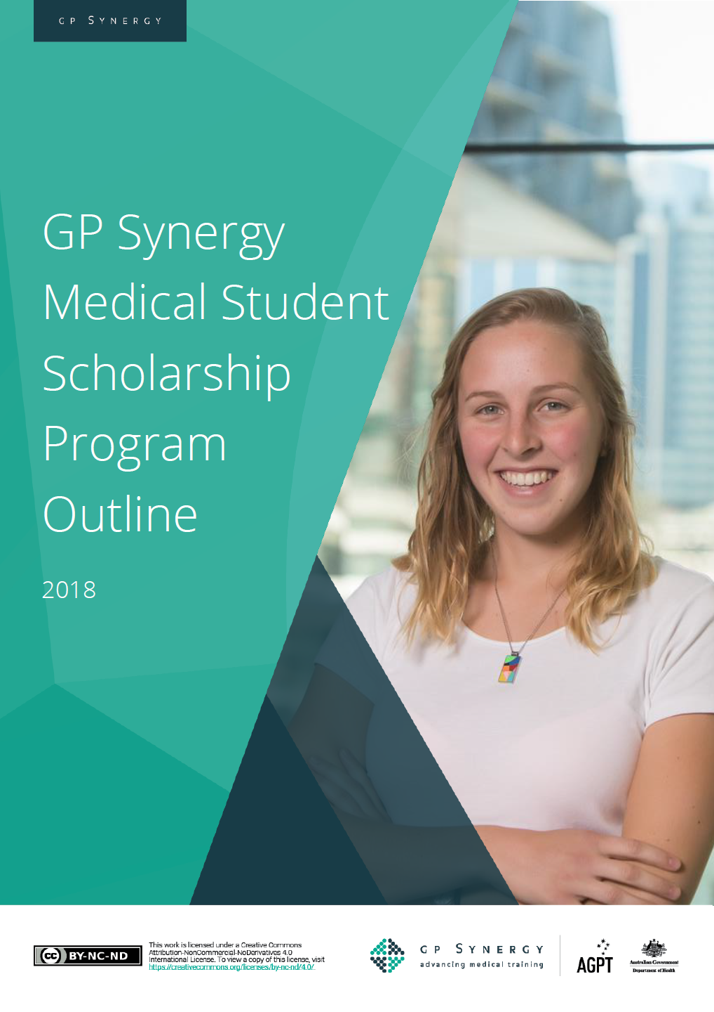

Slide 3
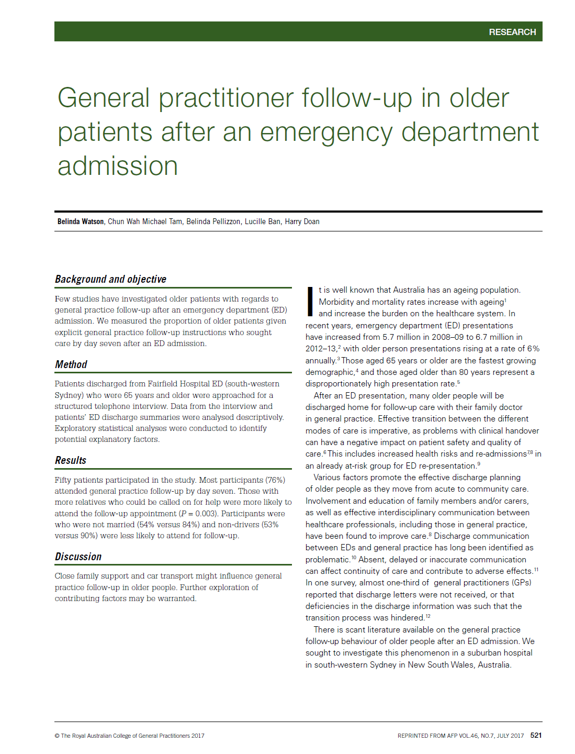
WATSON B, Tam CWM, Pellizzon B, Ban L, Doan H. General practitioner follow-up in older patients after an emergency department admission. Australian Family Physician 2017 July; 46(7): 187-192
tiny.cc/ED2GP

Slide 4
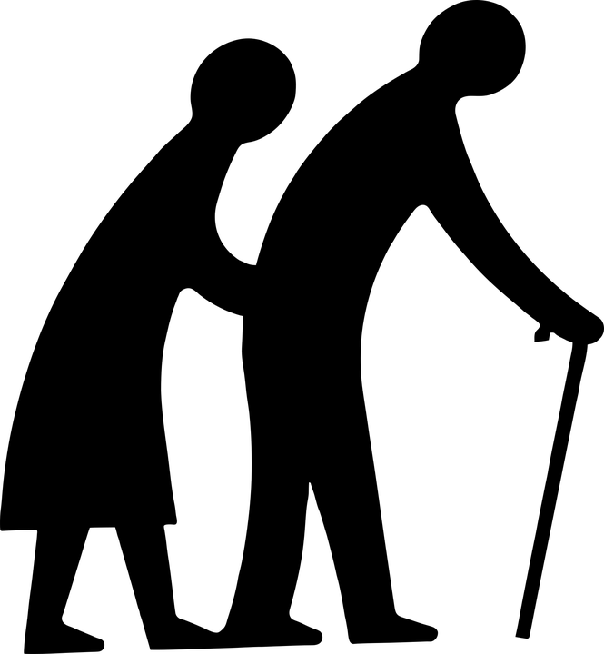
Background
?
GP

Slide 5
Background
?
GP

Slide 6
aim
?
GP

Slide 7
aim
?
GP

Slide 8
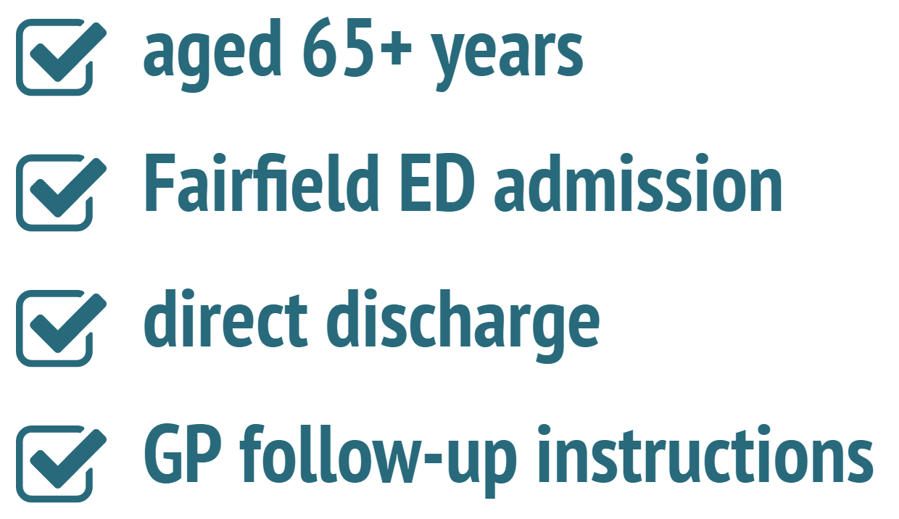
methods
8-14 days

Slide 9
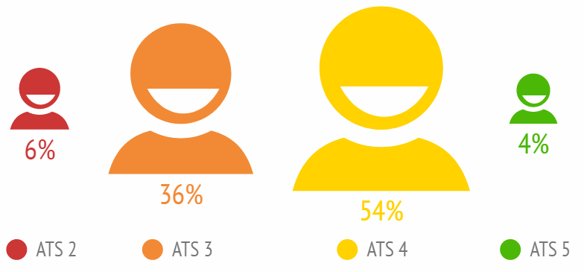
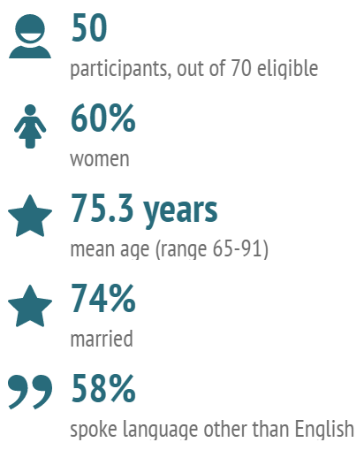
results
GP
4.8 km 3.8 km

Slide 10
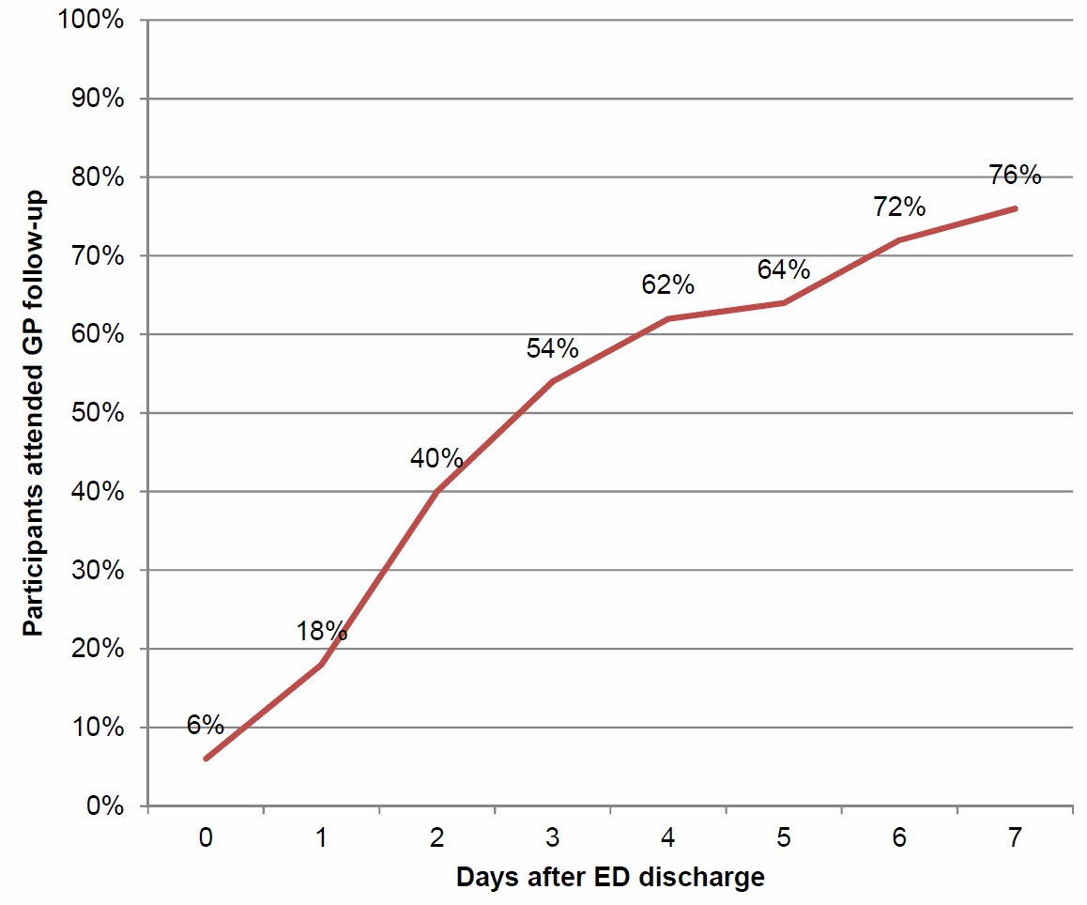
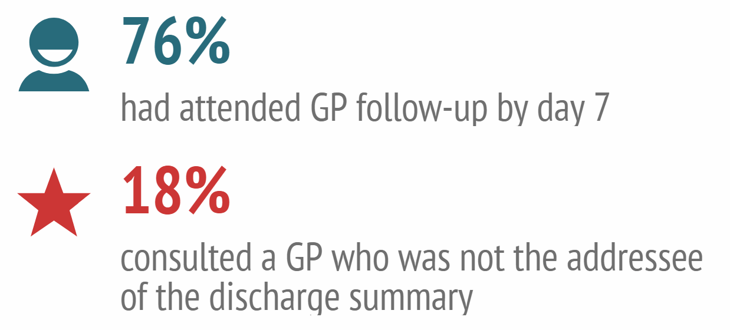
results

Slide 11
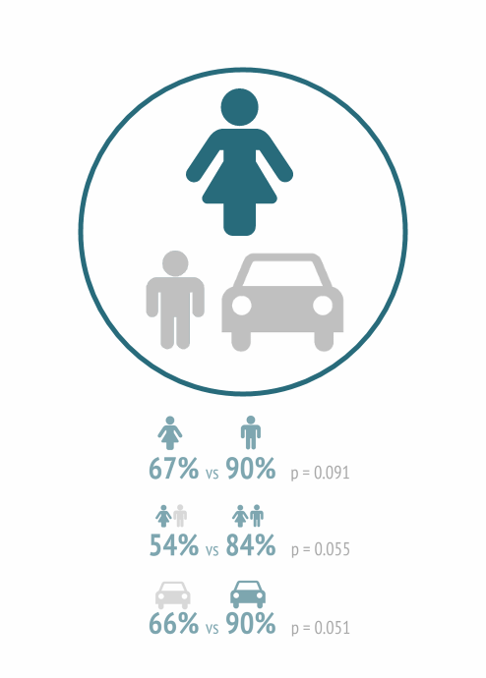
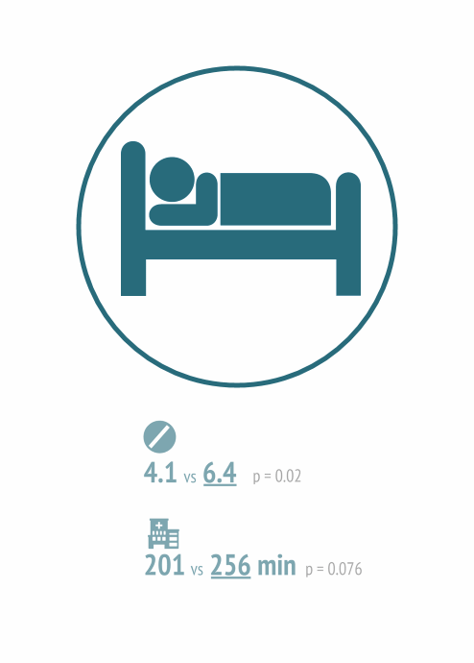
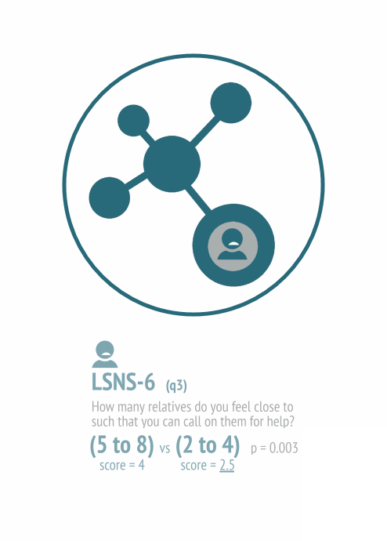
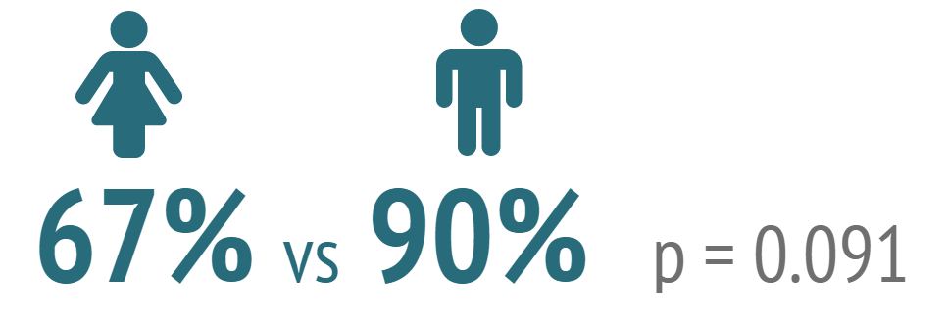
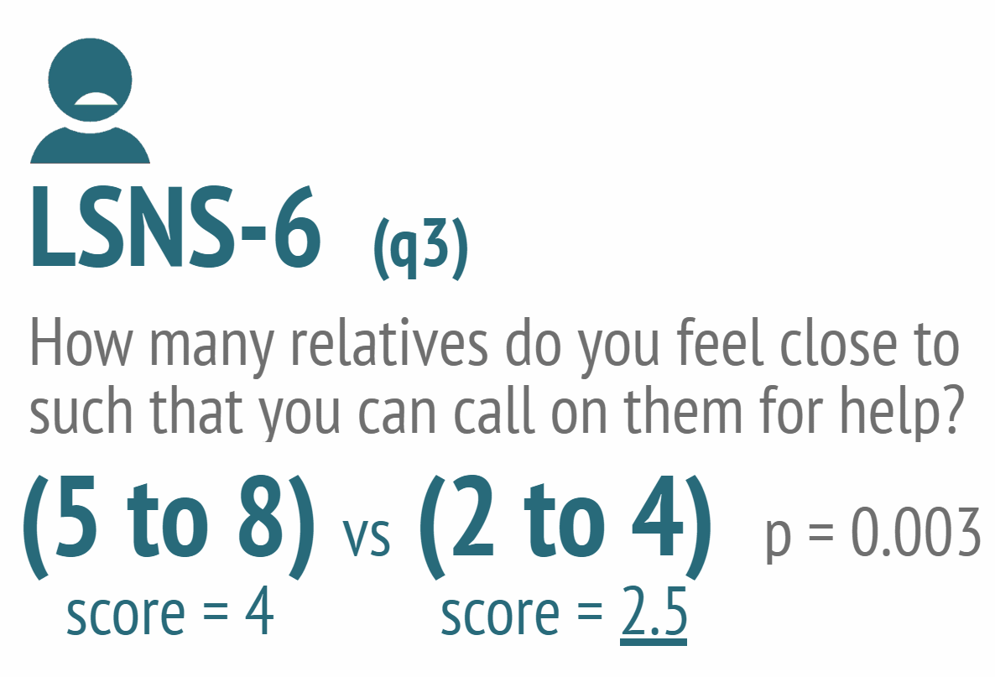
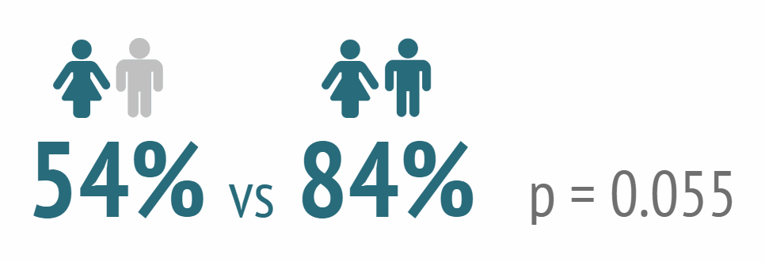
results

Slide 12
less access to
transport
less family
support
more ill patients
discussion

Slide 13
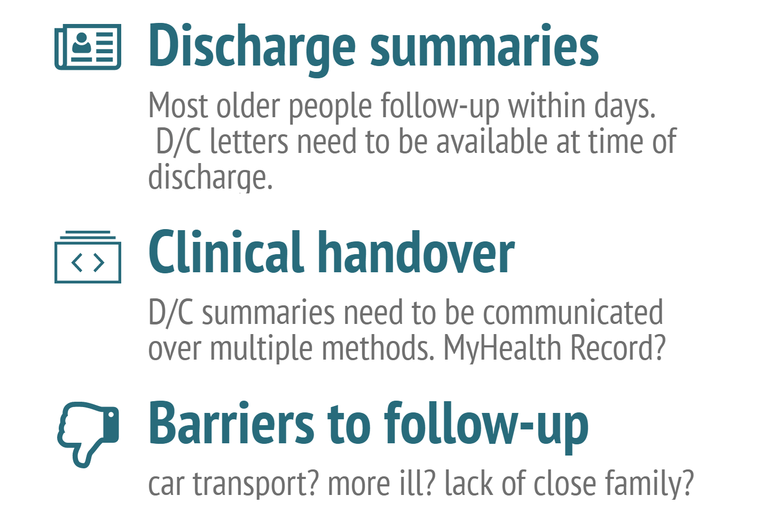
implications

Slide 14
replication at
another site
women
where next?

Slide 15
WATSON B, Tam CWM, Pellizzon B, Ban L, Doan H. General practitioner follow-up in older patients after an emergency department admission. Australian Family Physician 2017 July; 46(7): 187-192
tiny.cc/ED2GP
Dr Michael Tam, Senior Lecturer
Discipline of General Practice
michael.tam@sydney.edu.au

