Slide 1
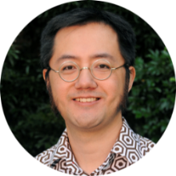
General practitioner follow-up in older patients after an emergency department admission
WATSONBelinda
medical student
PELLIZZONBelinda
TAMMichael
FRF ED NUM
BANLucille
General Practice Unit
m.tam@unsw.edu.au
+61 2 9616 8520
FRF ED co-director
DOANHarry
FRF director, medical services

Slide 2
Background
?
GP

Slide 3
Background
?
GP

Slide 4
aim
?
GP

Slide 5
aim
?
GP

Slide 6
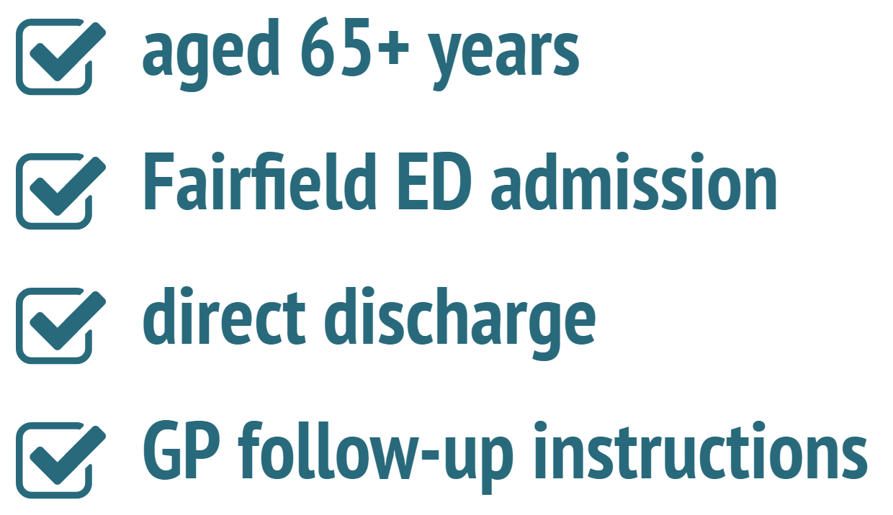
methods
8-14 days

Slide 7
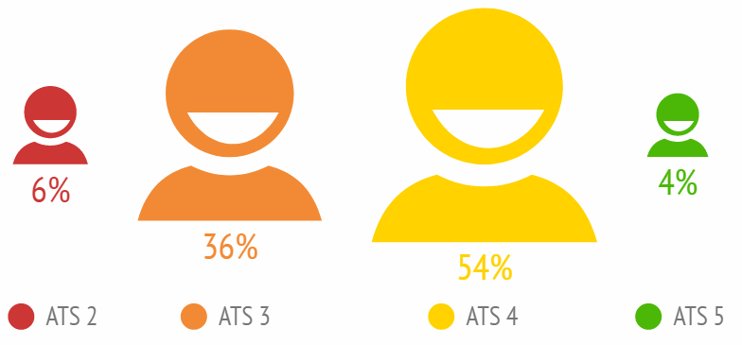
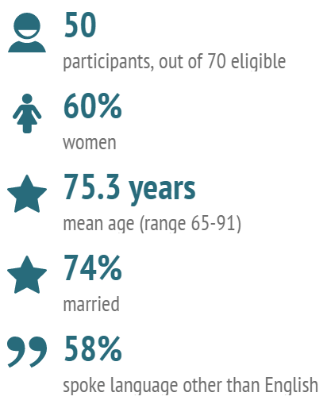
results
GP
4.8 km 3.8 km

Slide 8
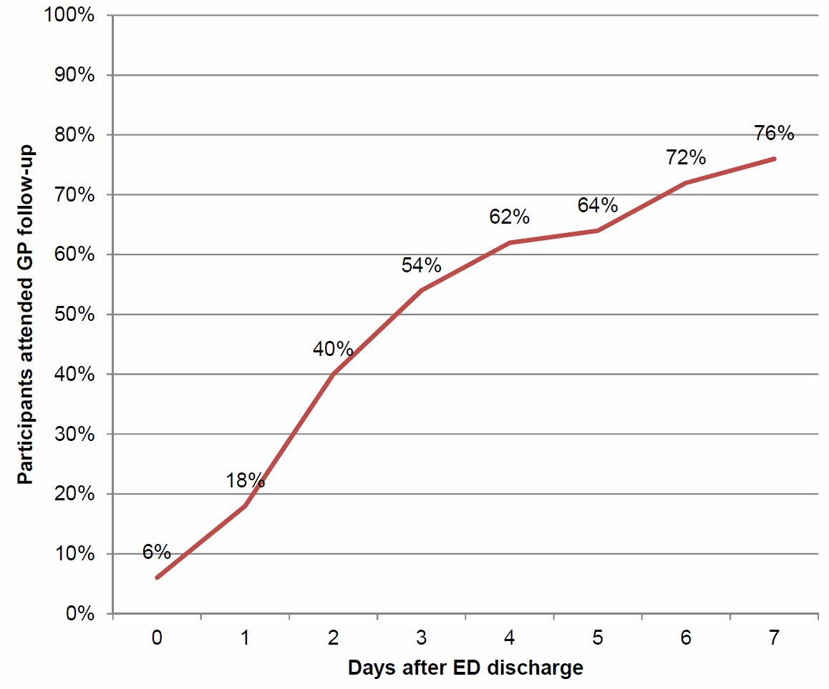
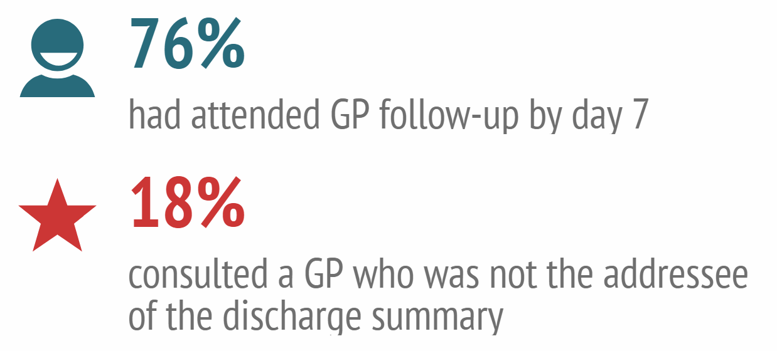
results

Slide 9
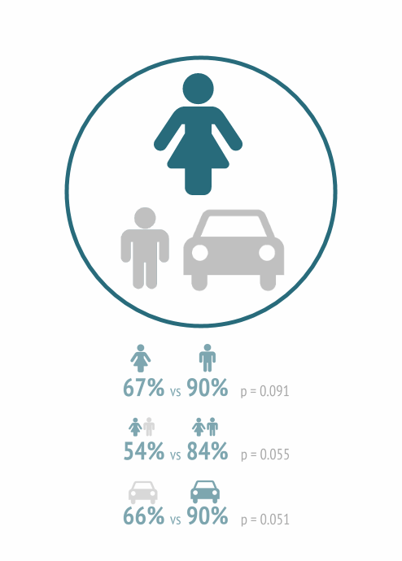
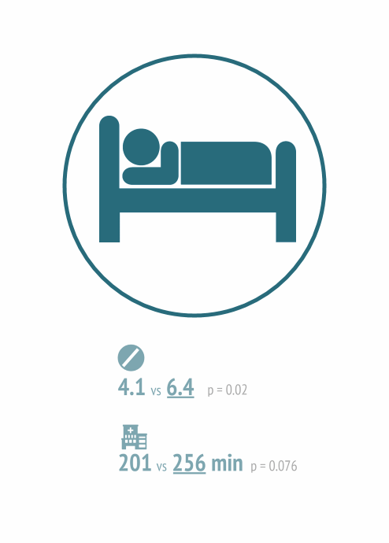
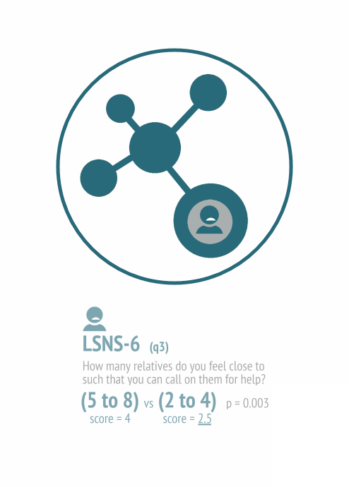
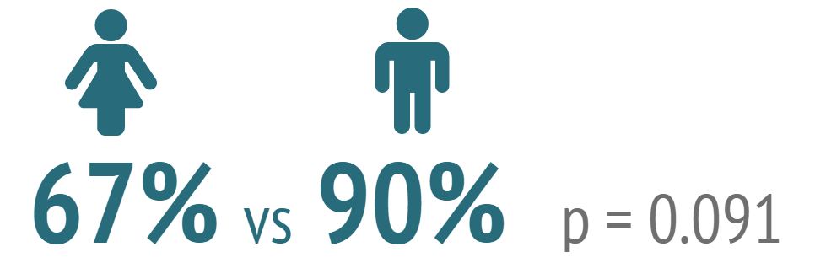
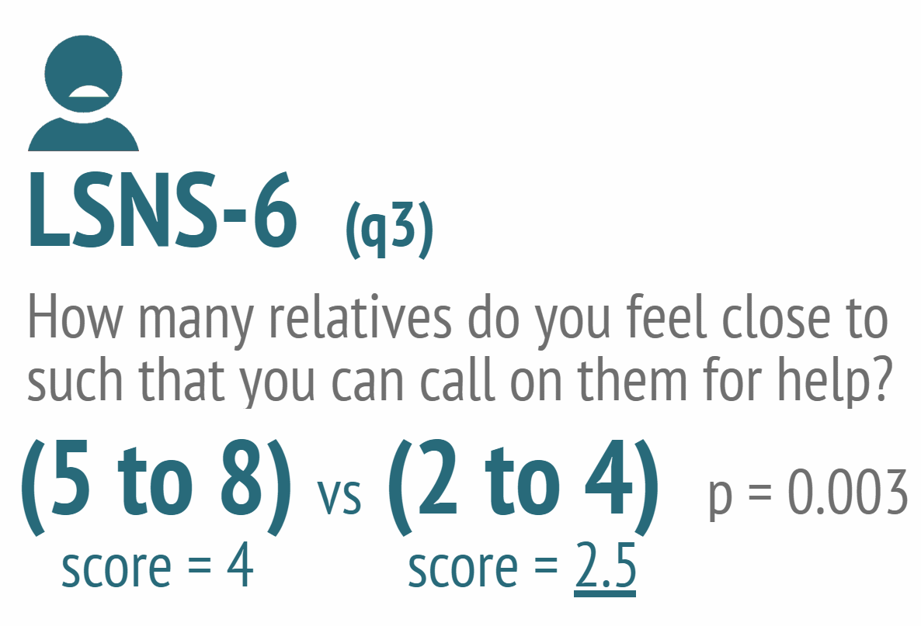
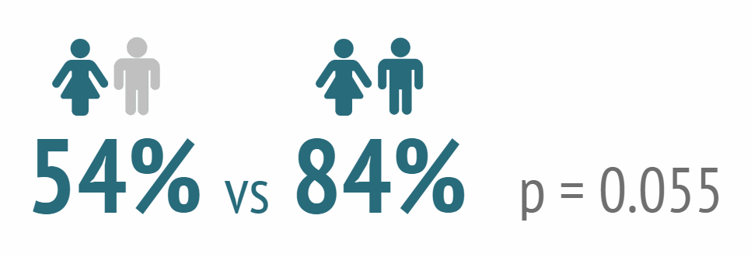
results

Slide 10
less access to
transport
less family
support
more ill patients
discussion

Slide 11
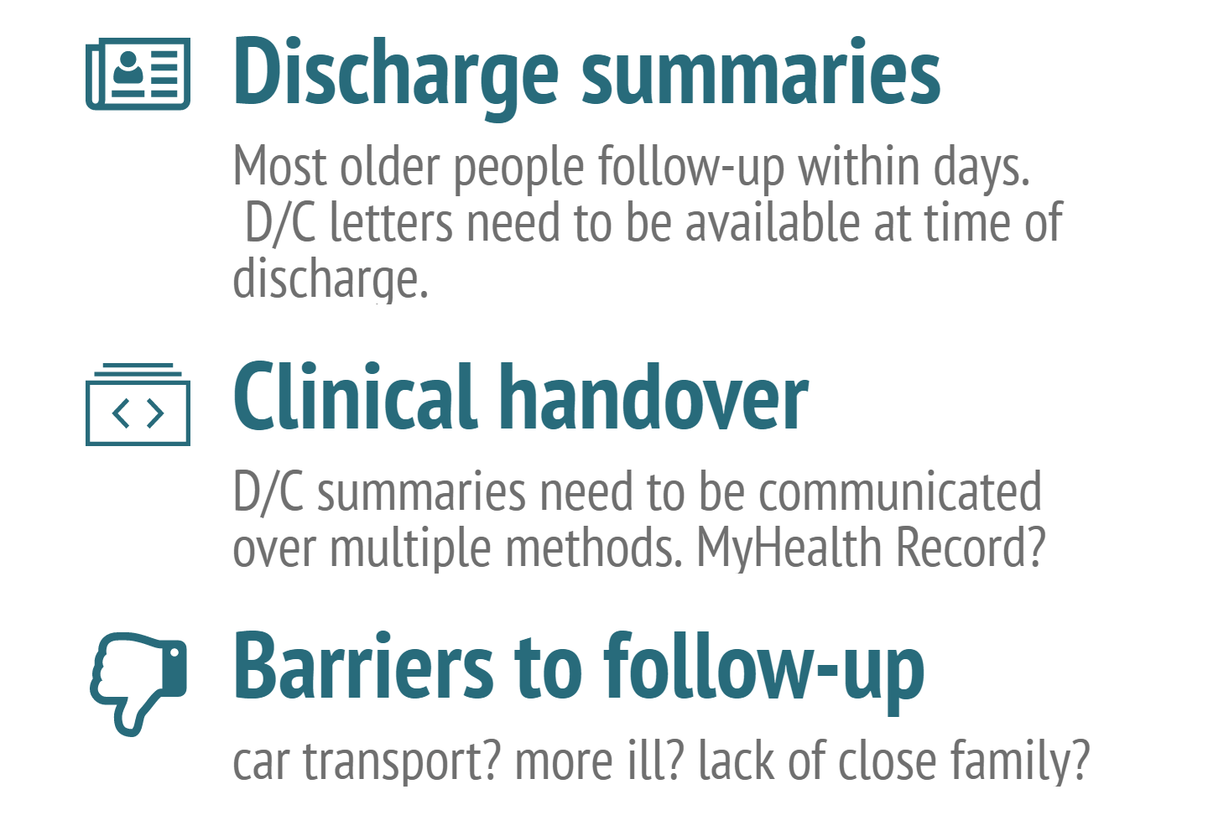
implications

Slide 12
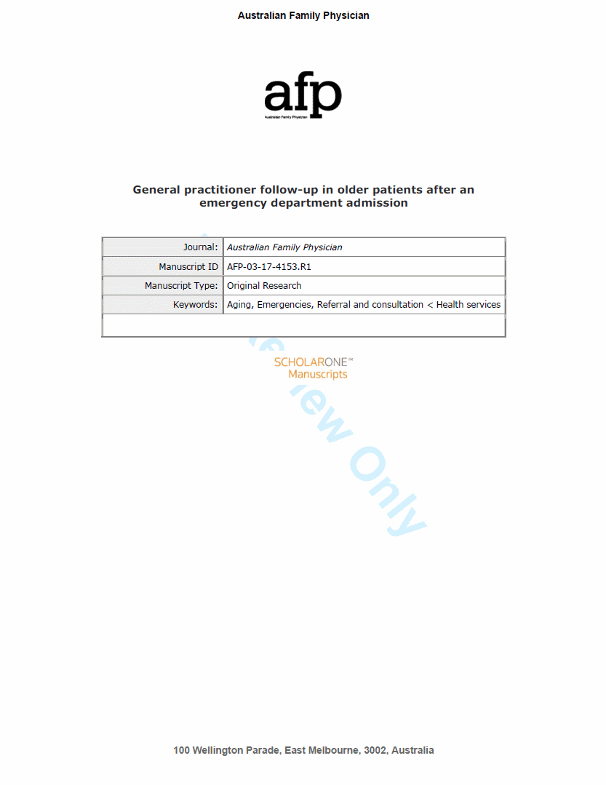
WATSON B, Tam CWM, Pellizzon B, Ban L, Doan H. General practitioner follow-up in older patients after an emergency department admission. Australian Family Physician. Forthcoming.
Ask for a copy!

Slide 13
General practitioner follow-up in older patients after an emergency department admission
WATSONBelinda
medical student
PELLIZZONBelinda
TAMMichael
FRF ED NUM
BANLucille
General Practice Unit
m.tam@unsw.edu.au
+61 2 9616 8520
FRF ED co-director
DOANHarry
FRF director, medical services

