Slide 1
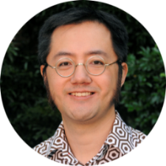
GP research
for GPs @
KHANAbeer
PRICEKaren
KNIGHTAndrew
LEEUWENBURGTim
MCLEANKatrina
TAMMichael
RHEEJoel
General Practice Unit
m.tam@unsw.edu.au
+61 2 9616 8520
HIGGINSNicole

Slide 2
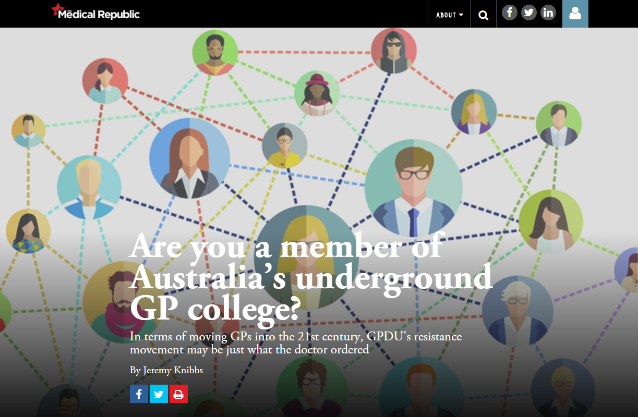
Background
“… national powerhouse of direct digital GP engagement in Australia and New Zealand”
The Medical Republic, 2017

Slide 3
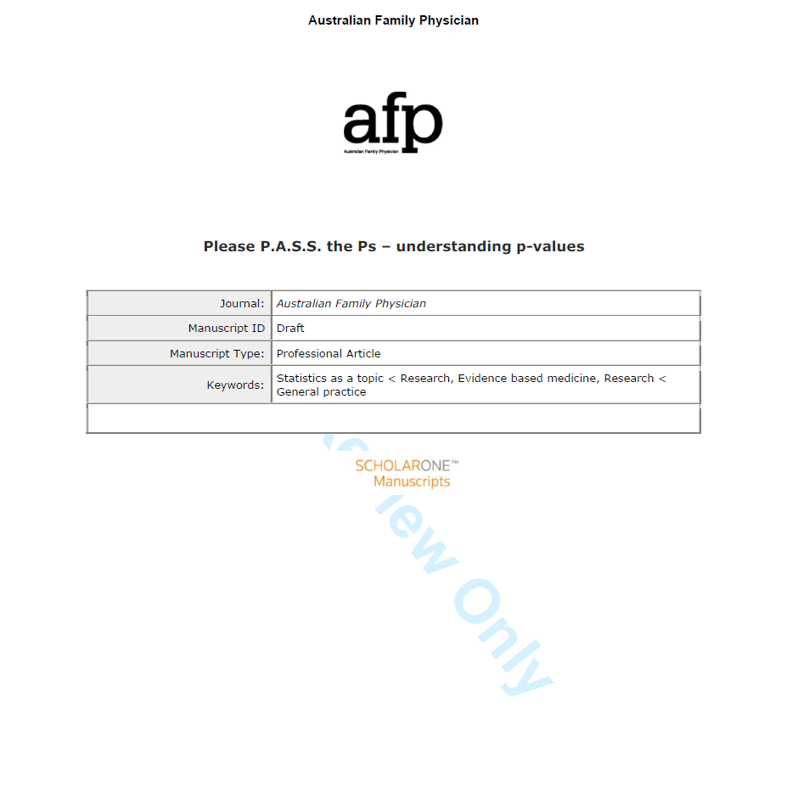
Background

Slide 4
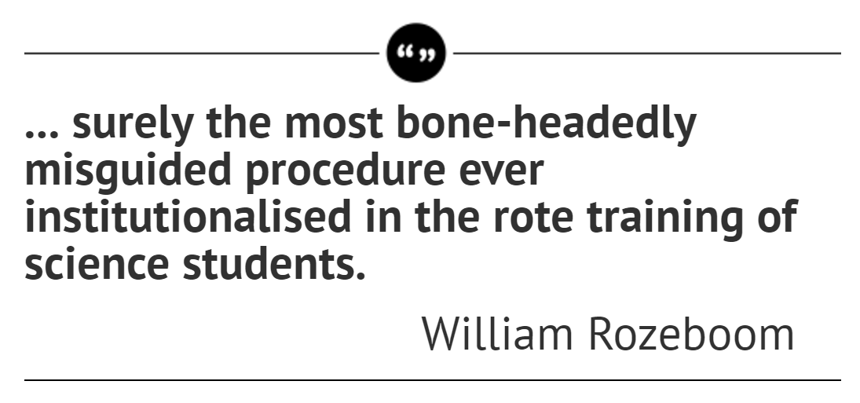
p
Journey

Slide 5
Journey
UNSW HC17503

Slide 6
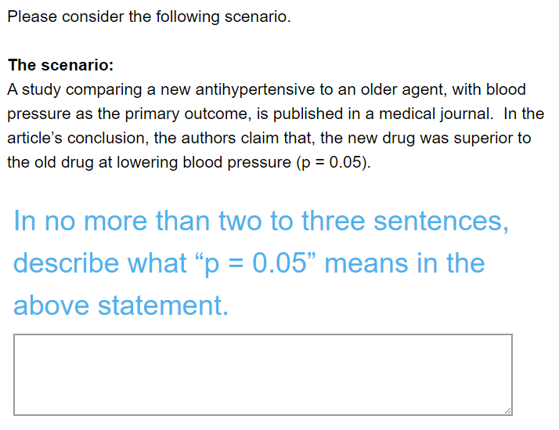
Journey

Slide 7
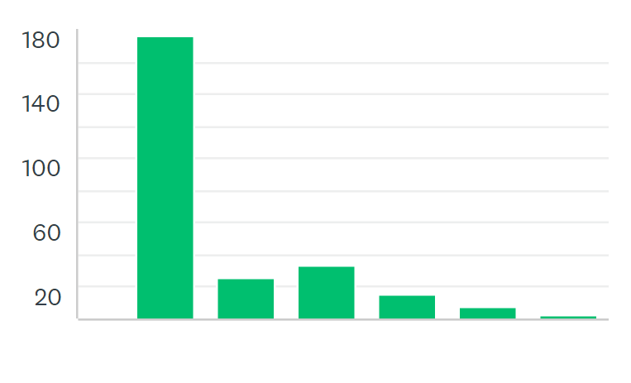
Journey
responses
week

Slide 8
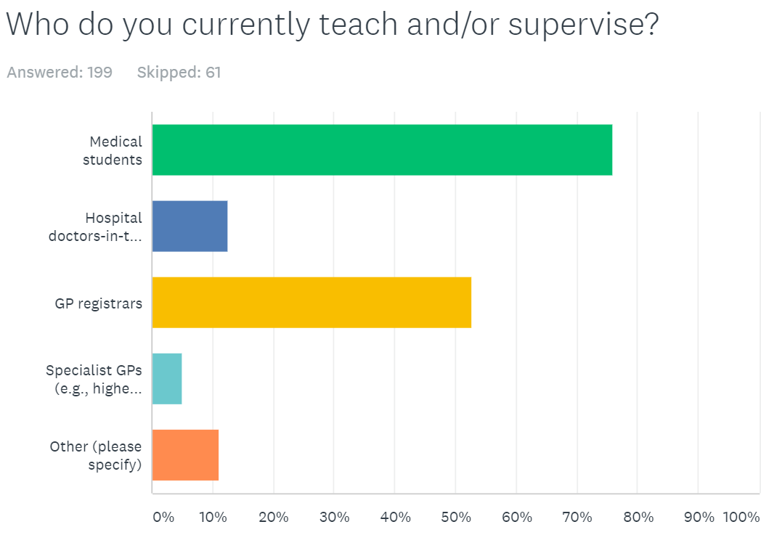
Journey

Slide 9
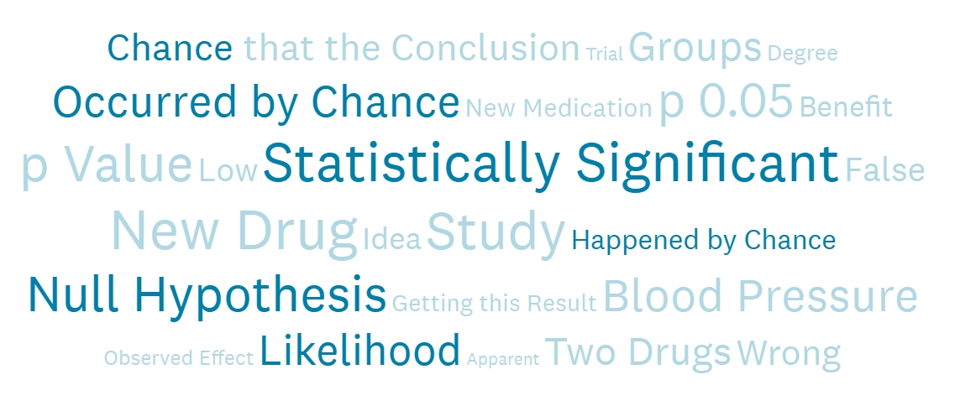
Journey

Slide 10
Journey
p

Slide 11
What’s next

Slide 12
GP research
for GPs @
KHANAbeer
PRICEKaren
KNIGHTAndrew
LEEUWENBURGTim
MCLEANKatrina
TAMMichael
RHEEJoel
General Practice Unit
m.tam@unsw.edu.au
+61 2 9616 8520
HIGGINSNicole

