Slide 1
Consulting in General Practice
What is happening in the consulting room?
School of Public Health and Community Medicine
Dr Michael Tam
GP and Lecturer in Primary Care

Slide 2
Aim
To equip you with the skills to understand the patient-doctor interactions that you will observe in general practice.
Notes:
Most of you will have a reasonably good understanding of medical consultations in the hospital setting. However, things can be different, and perhaps, quite confusing initially in general practice! When I was a medical student (a long time ago!) I undertook my GP rotation in my fifth year. One of my GP supervisors ran a very busy suburban practice – so he wasn’t able to explain to me what was happening in each of the consultations. And it was perplexing! The consultations to my fifth year brain seemed to run very fast. Many of the consultations did not run in the way I conceptualised medical consultations – i.e., a presenting complaint, then history, examination, etc. It took me a week or two before I started to understand the process of care that was occurring.
You guys don’t have very much time in general practice. This lecture is to equip you with the necessary framework so that hopefully, you won’t be quite as confused as I was! Hopefully, you will be able to understand and make meaning of the consultations that you will observe right from the beginning.

Slide 3
Learning outcomes
At the end of this learning activity, you should be able to:
Compare and contrast general practice care with hospital care
Describe the process of a general practice consultation
Explain the components of the patient-centred method

Slide 4
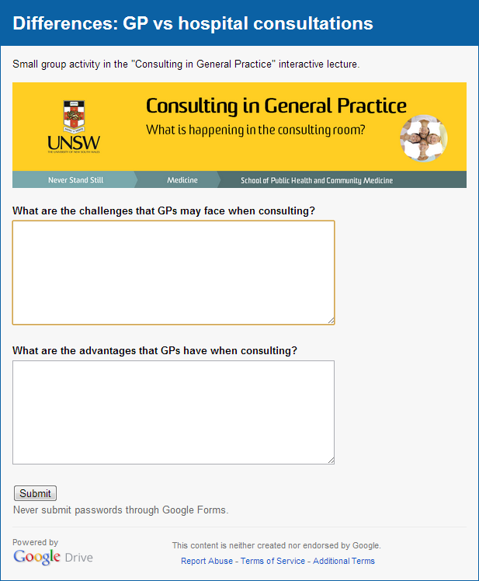
Differences: GP vs hospital consultations
Small group activity
Form small groups of 3-6 students
Each group must have at least one computer/tablet
Choose a scribe
Open the URL:
http://tiny.cc/gptask
Compare and contrast general practice care with hospital care
Notes:
This is a short “buzz group” activity. Students should come up with a reasonably good list. The URL loads an online form and the students can type out their answer and submit. Google can then create a summary page of all the submitted answers, which is then used to drive discussion. I use the student points to populate the framework (the list) that is in the following two slides. Generally, I won’t have to take much time to go through the next two slides.
In the rural campuses/smaller class sizes, this activity can either be done with butcher’s paper, or just a freeform discussion.

Slide 5
Differences: summary list
Patterns and severity of illness
Casemix → predictive value of history, signs, tests
Earlier presentations → undifferentiated and vague clinical features
Constraints
Time
Access to services
Costs
Scope of care
Preventive care, public and population health
Organisational role
Whole-person care
Patient involvement in care
Process for interventions
Importance of the patient-doctor alliance
Compare and contrast general practice care with hospital care
Notes:
Under “constraints”, it might be useful spending a little bit of time talking about Medicare, the MBS and PBS as students often aren’t very clear about the funding of health in the community sector.

Slide 6
Differences: summary list
Continuity of care
Depth of relationship
Management of ongoing problems
Use of time
Longitudinal and multi-visit nature of consultations
Use of time as diagnostic and management tool
Management versus diagnosis
Pathophysiologic diagnosis may not be necessary
“Rule out” versus “rule in”
Use of follow up
“Safety-netting”
Prioritising health issues
Proactive chronic disease care
Compare and contrast general practice care with hospital care

Slide 7
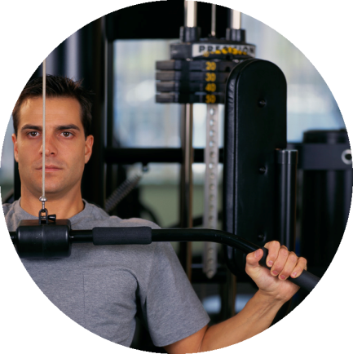
What is covered in a primary care consultation?
Management of
presenting problems
Modification of health seeking behaviour
Opportunistic
health promotion
Management of
Continuing problems
Stott NCH, Davis RH. The exceptional potential in each primary care consultation. Journal of the Royal College of General Practitioners 1979; 29: 201-205
Describe the process of a general practice consultation
Notes:
We start off first with what is perhaps most familiar – management of the presenting problem. However, if we look at the top 10 reasons for presenting to a GP in Australia, most of them are actually for the management of chronic health conditions. This is perhaps the first thing that is quite different to hospital care, except perhaps in the outpatient department. Parts of many consultations will be about health promotion – perhaps explicitly in advising and counselling patients to quit smoking, or more blended within the conversational flow – a two way discussion about diet and exercise, and attending follow up for screening activities. Sometimes, the main thrust of what the GP is doing is really about modifying health seeking behaviours – for instance, empowering parents to be able to manage self-limiting diseases in their children.
For most of you, observing the management of presenting problems is what will be familiar and comforting, and certainly, it is important. However, from the point of view of your learning in the primary care term, it is useful to focus somewhat on that which is less familiar, less comfortable and a little bit foreign. In this term, you have opportunities to observe and develop your knowledge and skills in: the management of continuing problems, opportunistic health promotion, and modification of health seeking behaviours, in real patient settings. The students who perform the best in the Primary Care OSCE usually do all four domains well.

Slide 8
Agendas
Doctor’s agenda
Patient’s agenda
Middleton JF. The exceptional potential of the consultation revisited. Journal of the Royal College of General Practitioners 1989; 39: 383-386
Negotiated plan
Describe the process of a general practice consultation
Notes:
10 years after Stott and Davis’ paper, Middleton revisited their framework. His insights are well worth exploring in depth. Now these concepts are probably not new to you and may even seem a little “obvious”. However, understanding these concepts in depth will allow you to analyse what is going on in your consultations you observe with your GP supervisors. Furthermore, being able to act and respond to them in your own consultations will make you better physicians.
In Stott and Davis’ framework, it is easy to think of “management of the presenting problems” as being the patient’s agenda. This is often true in hospital inpatients. However, this is not only insufficient in the primary care context, it is often also NOT in fact, the patient’s agenda. In general practice, it is very important to understand the antecedents to the patient presenting to you, today. It is better to consider “management of the presenting problems” as more the doctor’s agenda, how we perceive medical consultations should run, than the patients.
For consultations to run well and be successful, both the doctor’s and patient’s agendas, which might be very different, need to be addressed. As you may well imagine, this takes substantial skill – the goal is to negotiate a mutually satisfactory plan. Again, this is an area of learning you should consider devoting to in this term.

Slide 9
The patient-centred method
Stewart M, Brown JB, et al. Figure 1.1. In: Patient-centred medicine: transforming the clinical method, 2nd ed. Oxon, UK: Radcliffe Medical Press, 2003.
Explain the components of the patient-centred method
Notes:
We will spend some time on this slide. This is the interactive model of the patient-centred method as per Moira Stewart. We will discuss each of the 6 components of this model of the method, with reference to the models of Stott and Davis, and Middleton.
Important concepts to reinforce:
disease and illness are separate concepts
exploring both illness and disease are important in ascertaining the patient’s agenda
the patient is not just a collection of their diseases/illnesses – the “whole person”
learning about the whole person (which includes thinking about their family, community and environmental contexts) is not only just about building the patient-doctor relationship and establishing rapport → this is a critical component in facilitating and informing the negotiation of agendas and shared decision making
the patient-centred method is pragmatic – decisions and goals must be realistic or else they will not allow for meaningful outcomes.
Students can use this model to consider “how good” their supervisor’s consultations with their patients are. Also as a learning tool – HOW do their supervisors ask about their patient’s illness experiences? How do they “understand the whole person”? How do they “find common ground”, etc.? It is not enough to simply know and explain the model. We hope that students will develop knowledge and skills in this term to accomplish these components in their patient consultations.

Slide 10
Further learning – for those who want a deeper understanding
Read the web article “Consultation Analysis” on the Patient.co.uk website: http://www.patient.co.uk/doctor/Consultation-Analysis.htm
David Pendleton et al. developed seven basic “tasks” of the consultation.
Explain how these seven tasks can be mapped to the patient-centred method model developed by Stewart et al.
Analyse one of your GP supervisor’s consultations with a patient with complex care needs.
Explain the components of the patient-centred method
Notes:
This is for those students who want to understand consultations at a deeper level. Pendleton’s “tasks” are used for consultation analysis – keen students wanting deeper understanding and are aiming for a P+ should consider using it as a framework at examining their GP supervisor’s consultations. However, it is important to consider this in the context of the patient-centred model.

Slide 11
Aim revisited
To equip you with the skills to understand the patient-doctor interactions that you will observe in general practice.

Slide 12
References
Middleton JF. The exceptional potential of the consultation revisited. Journal of the Royal College of General Practitioners 1989; 39: 383-386
Stott NCH, Davis RH. The exceptional potential in each primary care consultation. Journal of the Royal College of General Practitioners 1979; 29: 201-205
Stewart M, Brown JB, et al. Patient-centred medicine: transforming the clinical method, 2nd ed. Oxon, UK: Radcliffe Medical Press, 2003.
Draper R. Consultation analysis [website]. Updated 2010 Feb 19 (Retrieved 2014 Jan 12). Available from: http://www.patient.co.uk/doctor/Consultation-Analysis.htm

