Slide 1
Absolute cardiovascular disease risk
Assessment and Early Intervention
Dr Michael Tam
Lecturer in Primary Care
m.tam@unsw.edu.au
Notes:
Qs:
1) Who has heard about this concept already - Cardiovascular Disease Risk Assessment?
2) Why is this topic important? Or worthwhile?
So can help people – motivate patients to change their risk of CVD.
Think more about the words in the title: absolute risk, CVD risk assessment.
Note heading for lecture has “absolute” first - Australian guidelines have absolute first in name
Also commonly referred to as CVAR – so the “absolute” is after cardiovascular. As both terms in use - have used both for this lecture on purpose

Slide 2
Aim
To demonstrate the clinical application of absolute cardiovascular disease (CVD) risk assessment
Notes:
The aim of this lecture is to show you how and why absolute cardiovascular disease risk assessment could (and should!) be performed in clinical practice.
To achieve this, we will integrate the various bits of knowledge that you may know and put it all together. We will
revise cardiovascular risk from the theory
moving onto statistical concepts
consider the influences of socioeconomic and health system factors
think about role and purpose of health care and the clinician
understanding on how and why these concepts influence clinical reasoning
and merging all that into making decisions for specific patients.

Slide 3
Learning objectives
Explain the benefits of absolute CVD risk assessment
Identify the information required to use the CVD risk charts and calculator
Demonstrate the use of the CVD risk assessment tools
Describe the management of a patient’s cardiovascular risk according to best practice guidelines
Notes:
These are the four learning objectives and we will use these to guide this learning activity.
The levels of expectations of your understanding and depth of knowledge are captured in these objectives – and have ramifications to your phase 2 assessments. In terms of your knowledge of the benefits of conducting ACVD risk assessment, this is a critical part of this lecture and we expect it at a high level – hence, “explain”.
You will need to be familiar with the assessment process and be able to “identify” the information you need to conduct this assessment.
You are expected to be able to demonstrate competent use of the specific risk assessment tools that we will be introducing/revising in this activity.
As this is phase 2, you will need to start thinking in terms of practical patient care and have a knowledge of management. At this level, you should be able to describe the general evidence-based strategies of managing cardiovascular risk.

Slide 4
Two patients
Wendy
Greg
Age 53
Ex-smoker for 7 years
2-3 standard drinks/day
BP 165/95
2 serves of fruit a day
BMI = 30
Total chol = 7.0 mmol/l
HDL = 1.4 mmol/l
No diabetes
Age 65
Non smoker
2 standard drinks/day
BP 145/92
10 min of exercise a day
BMI = 25
Total chol = 5.6mmol/l
HDL = 0.7 mmol/l
No diabetes
who is at higher cardiovascular disease risk?
Notes:
These are two patients who would not be out of place in general practice. Neither of them is unwell at this time. Who is at greater risk for CVD?
Give students a minute to ponder... Then ask for a show of hands. (note: Wendy = 7%, Greg = 20%)
The majority of the students will believe that Wendy is at greater risk.
Select someone who thought Wendy was at greater risk: how would you manage Wendy?
typically, they will talk about lifestyle changes; will they start BP medications/lipid lower agents?
How would you manage Greg? What would be different?
typically, would not start medications at this time.
At the end of the lecture, we will come back to Wendy and Greg and apply what we have learnt.

Slide 5
What is “cardiovascular disease”?
Coronary heart disease
e.g., angina pectoris, myocardial infarction
Cerebrovascular disease
e.g., stroke, TIA
Peripheral vascular disease
e.g., intermittent claudication
Explain the benefits
Notes:
Firstly, let’s examine the first learning outcome: explain the benefits of absolute CVD risk assessment
First issue, what is CVD?
The term cardiovascular disease is used collectively in this lecture and in the literature to refer to these three conditions. There are many different clinical endpoints. Nevertheless, they tend to have common risk factors, particularly related to atherosclerosis.

Slide 6
CVD – important, common and preventable
Prevalence
3.7 million people (1 in 6 Australians)
Death
1/3 of all deaths (2010)
Most common cause
Disability
1.4 million people
Impact
½ million hospitalisations per year (2009-10)
$$$ - about 11% of total health expenditure (2004-5)
Risk factors
> 9 in 10 adults at least one
2 in 3 with 3+ risk factors
Explain the benefits

Slide 7
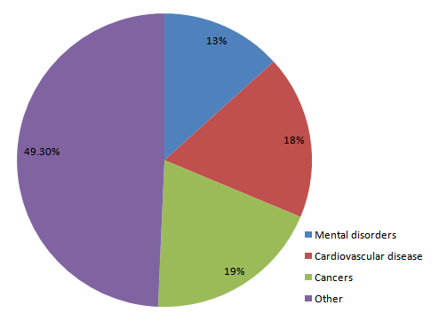
Burden of disease (DALY)
Explain the benefits
Notes:
Burden of disease (DALY): mental disorders = 13%, CV disorders = 18%, cancers = 19%
Ask the students, anyone remember what DALY is? More importantly, why do we use it as a measure of “burden of disease”? Why not just mortality?
The students will probably talk about: allows comparisons between diseases (e.g., mental disorders don’t cause much death compared to CV disease and cancer, but many years of disability)
Explain: in S&H, you will receive some lectures later from Dr Parker on ethical concepts in public health and how some of these frame and justify some of our behaviours as clinicians, and justify health policies. One of the concepts you will encounter is utilitarianism, the moral philosophy developed by Jeremy Bentham and John Stuart Mill - aphorised by the statement “the greatest good for the greatest number”. The concept here is that “utility” is a measure of “well-being” or “happiness”; DALY is a measure of utility, or, an attempt to quantify how much the disease impacts on “well-being”. It is important here to recognise a public health concept here; the purpose of the health system is to maximise well-being of the population. Always try to remember, what is your “purpose” as a clinician, in your interactions with patients.

Slide 8
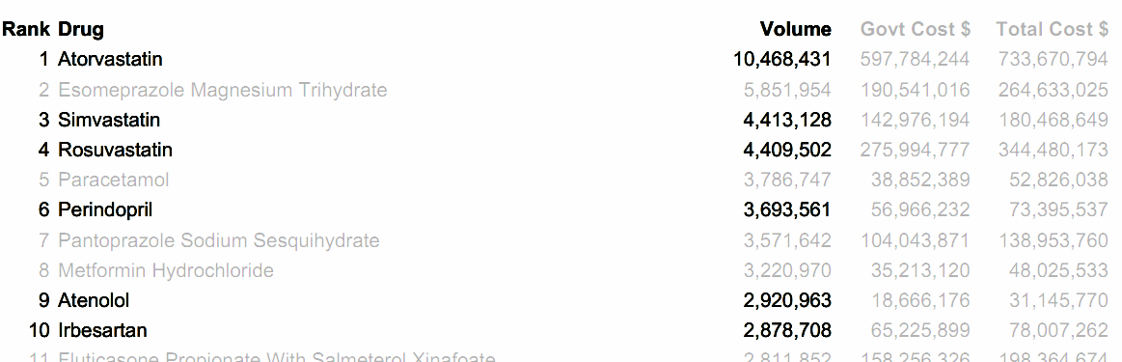
Cost and volume of drugs (year ending 2010)
Cost
Volume
Explain the benefits
Notes:
This is the PBS, pharmaceutical benefits scheme data for the year ending 2010. The PBS is the Federal Government funded scheme that subsides the cost of medications in the community. When a patient in Australia gets a prescription from a doctor, and goes to a community pharmacist; if it is listed on the PBS, then the maximum that the patient will pay is $35.40 (2012), or $5.80 if they are a concession card holder.
The top 3 drugs in terms of cost are cardiovascular drugs. Atorvastatin and rosuvastatin cost the Australian health system over a billion dollars! The next time a Pfizer rep gives you a Lipitor pen, or an Astra Zeneca rep gives you a Crestor mug, that is why!
By volume, 6 of the top 10 drugs are cardiovascular drugs! The cost to the health care system is not-insubstantial.

Slide 9
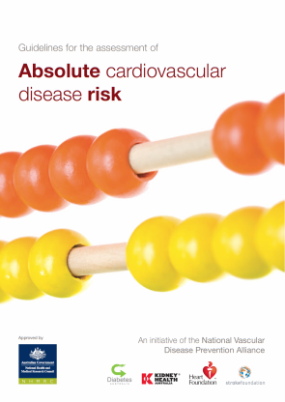
What are the CVD “risk factors”?
Adapted from (p. 6):
Modifiable risk factors
smoking
blood pressure
serum lipids
waist circumference and BMI
nutrition
physical activity level
alcohol intake
Non-modifiable
age and sex
family history
social history (cultural identify, ethnicity, SES, mental health)
Related conditions
diabetes
chronic kidney disease
familial hypercholesterolaemia
atrial fibrillation
Explain the benefits
Notes:
Firstly, let’s examine the first learning outcome: explain the benefits of absolute CVD risk assessment
So we’ve revised what is CVD, but what are the CVD risk factors?
Ask: what are the risk factors for cardiovascular disease?
This list is taken from Quick reference guide for health professionals - Absolute cardiovascular disease risk assessment. Different classifications exist.
Many studies have shown interaction between risk factors
Risk factors do not necessarily imply causation - but may be markers of underlying disease
Presence of multiple risk factors have a greater than additive effect on overall or absolute risk
So lots of scope - modifiable behaviour to engage with our patients to improve their surviving
NB: You can mention other risk factors listed below which are not displayed in the slide (the ‘old’ list – not sure of the source – different categorisation):
Other major modifiable risk factors include:
chronic renal failure / microalbuminuria
central abdominal obesity
psychological factors
Other risk factors have also been described:
CRP
homocysteine level ←→ homocysteine level has been debunked, it does not appear to be a risk factor
lipoprotein A level
Triglycerides
uric acid
Fibrinogen
Non-modifiable risk factors:
significant FHx doubles risk of coronary event
left ventricular hypertrophy on ECG
socioeconomic status (deprivation is an independent risk factor)
Can refer to SNAP risk factors - Smoking, Nutrition, Alcohol, Physical Activity

Slide 10
What is “absolute risk”?
Absolute risk
Relative risk
The numerical probability of an event occurring within a specified period.
e.g., in Australia we use 5-year CVD absolute risks → the probability of having CVD in the next 5-year period.
The ratio of the rate of events between two populations.
e.g., smokers have a higher relative risk of CVD compared to non-smokers.
The risk value can be expressed in a number of different ways, e.g.:
1 in 10 = 10% = 0.1
Explain the benefits
Notes:
Firstly, let’s examine the first learning outcome: explain the benefits of absolute CVD risk assessment
- OK, we’ve covered CVD and CVD risks, but what about this term “absolute risk”?
This is just some quick revision to make sure that we all know what we are talking about.
Absolute risk is the probability of something occurring within a specified time frame. For instance, we all have an absolute risk of developing diabetes by age 60 and this could be expressed numerically.
The relative risk is a ratio of the rate of events between two populations. For instance, smokers have a higher relative risk of CVD compared to non-smokers
The risk value can be expressed as a “1 in x”, as a percentage, or as a proportion. You need to be able to work in all three ways.
For more info on this topic, go to (access free online at http://www.cmaj.ca/cgi/content/full/171/4/353):
Barratt A, Wyer PC, Hatala R, et al, for the Evidence-Based Medicine Teaching Tips Working Group. Tips for learners of evidence-based medicine: 1. Relative risk reduction, absolute risk reduction and number needed to treat. CMAJ 2004; 171: 353–358.

Slide 11
Working with numbers – examples
Let’s say that the baseline risk of CVD is 12% by age 60:
i.e., absolute risk_{(baseline)} = 0.12 = 12%
If drug X reduces the likelihood of CVD by 25%, then:
relative risk reduction_{(drug X)} = 0.25 = 25%
The absolute risk of CVD by age 60 if drug X is used:
AR_{(drug X)} | = AR_{(baseline)} × (1 - RRR_{(drug X)}) = 0.12 × 0.75
AR_{(drug X)} | = 0.09 = 9%
Explain the benefits
Notes:
A scenario to work through...

Slide 12
Working with numbers – examples
Now:
Also: So:
absolute risk reduction | = AR_{(baseline)} − AR_{(drug X)} = 0.12 − 0.09
ARR | = 0.03 = 3%
NNT_{(drug X)} | = 1 ÷ 0.03
 | ≈ 33
Explain the benefits
Notes:
So in this scenario, the absolute risk reduction of using the drug is 3% by age 60. That gives an NNT (number needed to treat) of 33.
It’s worthwhile asking students to explain what NNT means: the number of patients who need to receive the treatment, for 1 additional person to have the beneficial outcome, as compared to the alternative (which in this case one assumes is not treating with drug X). In this scenario, that would be about “33”... i.e., 33 people need to receive drug X for one to benefit.

Slide 13
Why use ARR and NNT?
Explain the benefits
Notes:
Look at these 4 different populations. Let’s say that the AR refers to the risk of having a heart attack in the next 12 months. Patient 1 might be someone sitting in a coronary care unit. Patient 4 is much more typical of someone that I would see, a well person in general practice.
As what is typical with using a drug, the relative risk reduction is about the same throughout risk categories. In this scenario, the drug might be a statin and the risk is reduced by 25%. However, look at the potential impact!
We only need to treat 8 patients who are like patient 1 to prevent one of them from dying by 12 months. That’s pretty major. That effectively means that in a typically CCU at this time, 1 or 2 patients treated with this drug, compared to not treated, won’t die. However, in the community setting, the drug is much less useful! Even if I prescribed this drug for all my patients, the odds are that it won’t make a difference to a single one of them!
Using ARR and NNTs allow us to have a much better sense of the utility of treatments.
NNT can be better than ARR in expressing the risks as the numbers are more intuitive to understand – but it doesn’t actually convey more information.

Slide 14
“Absolute” vs. “Individual” CVD risk approach
“...[risk] depends more closely on the combination and intensity of risk factors than on the presence of a single risk factor, because the cumulative effects of multiple risk factors may be synergistic.”
From “Executive Summary”
(p. 2):
Explain the benefits
Notes:
Okay, so we’ve covered the basics now with regards to the terminology. So, “explain the benefits”...
This slide contains a major concept and it is worth letting this sink in. You should ask yourselves, why should we use this concept of “absolute CVD risk”?
In the previous slide, we’ve identified many different risk factors. Why not just address each as it comes? The answer to this has to do with the fact that often it is the total “package” of risk factors that is important, also on human psychology. By managing individual risk factors alone, it is easy to focus on something that has less benefit. A good example is in the management of type 2 diabetes. Ask the class, “what is the target for type 2 DM”? Hopefully, someone will say an HbA1c of less than or equal to 7% (53).
Reflect that it is not uncommon for doctors to conceptualise diabetes as a “sugar disease” and thus focus their efforts in lowering the HbA1c. It is then easy to lose sight of the fact that diabetes is also effectively a “cardiovascular disease” and often, there may actually be more to be gained in some situations by improving blood pressure and lipid control, than an incremental improvement in HbA1c.
Reflect on the slide we just saw before of the 4 patients with different risks. As humans, we have a centering bias – we often under-estimate large risks, and over-estimate small ones. The result? We often undertreat individuals who would benefit from the intervention the most, and overtreat individuals who would benefit the least. Think about the data earlier on of the high cost and use of statins. To whom are these drugs going to? In terms of public health, remember that health expenditure is often “zero sum” – the opportunity cost of one person receiving a treatment is that somebody else does not.

Slide 15
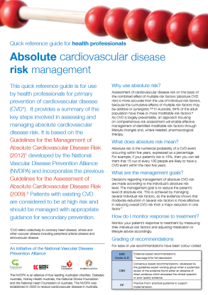
Risk assessment algorithm
Adapted from (p. 2):
Target group
Information to gather
Already at high risk?
if “no”, use risk calculator
Management
Identify the information
Notes:
This is the CVD Risk Assessment algorithm and we’ll go through it in parts. The overview – who should be target for assessment (i.e., who should we screen?), the information we should be gathering, who is already at high risk? Using the calculator and then important, using the risk assessment to inform our management.

Slide 16
Target group
All adults aged 45 years and over without known history of CVD.
Aboriginal and Torres Strait Islander peoples aged 35 years or older.
Identify the information

Slide 17
Comprehensive risk assessment
Adapted from (p. 6):
Modifiable risk factors
smoking
blood pressure
serum lipids
waist circumference and BMI
nutrition
physical activity level
alcohol intake
Non-modifiable
age and sex
family history
social history (cultural identify, ethnicity, SES, mental health)
Related conditions
diabetes
chronic kidney disease
familial hypercholesterolaemia
atrial fibrillation
Identify the information
Notes:
We have previously identified the risk factors → again, these are the things we want to gather in our history in particular, and examination. Some of the information allows us to calculate risk, but detailed knowledge especially of the modifiable risk factors allow us to think about areas we could intervene and individualise care.

Slide 18
Who is already at “high risk" of CVD?
Adapted from (p. 23):
Existing history of CVD
angina
myocardial infarction
ischaemic heart disease
stroke
TIA
peripheral vascular disease
intermittent claudication
etc.
These conditions:
diabetes and age > 60 years
diabetes with microalbuminuria
moderate or severe chronic kidney disease (persistent proteinuria or eGFR < 45)
familial hypercholesterolaemia
systolic BP ≥ 180, or diastolic BP ≥ 110 mmHg
serum total cholesterol > 7.5
Identify the information
Notes:
Now, we’ve spent some time looking at why absolute cardiovascular risk assessment is a good idea.
Let’s have a look at HOW we can do this. Firstly, as we are concerned with determining risk, who is already considered at HIGH risk? Clearly, individuals with existing CVD. For those without existing CVD, a number of other conditions have been identified. So clearly in our assessment process which will include history, examination and perhaps some investigations, we should cover these bases.
We are going to talk about using the Australian CVD absolute risk calculator later, but if you are already at high risk, there is no need to use the calculator.

Slide 19
CVD absolute risk categories
Australia: 5-year risks
Low: < 10%
Moderate: 10-15%
High: > 15%
Identify the information
Notes:
It is important that when you see the terms “low risk”, “moderate risk” and “high risk” in the literature, these qualitative descriptors are not being used subjectively.
In Australia, we describe CVD absolute risks over a 5-year period. It is important to note that in some other countries (e.g., US and Canada), CVD absolute risks are described over a 10-year period.
“High risk” is greater than 15% risk of CVD in the next 5 years.

Slide 20
Using the calculator
So for those who are not already considered to be at “high risk” we should use the Framingham Risk Equation to calculate risk levels.
Demonstrate the use
Notes:
The Framingham Risk Equation comes from data from the Framingham Heart Study. Now, as you guys are going to be clinicians, I’m not going to inflict on you the use of the original published tables. Rather, we are going to use the Australian specific calculators. You will be expected to know how to use this and this is absolutely examinable both in phase 2 and 3!

Slide 21
Framingham Heart Study
Major epidemiologic research
Started 1948 in Framingham, MA
Study into the causes of CVD
Now into the 3rd generation of participants
Demonstrate the use
Notes:
This is a major study with the original cohort starting in 1948. These were residents in Framingham, Massachusetts in the US. The context of the study is that at the time, CVD mortality was steadily rising in the US but the general causes of heart attacks and strokes were unknown. Historical trivia – when were the studies looking at aspirin’s role in the management of CVD done? (1970s and 1980s).
The Framingham Heart Study is how we know that blood pressure, smoking and hypercholesterolaemia increase the risk of heart attacks and strokes – and moreover, allow use to quantify that risk.
It is important, however, to be aware of some of the limitations of this tool as well. The participants obviously reflect the population of Framingham, MA. It is likely that the risk for people who are obese/morbidly obese, or those who have diabetes, or those who suffer from enduring socioeconomic disadvantage are underestimated by the tool.
FYI only - no need to mention this:
The citations for the relevant scientific papers are:
Anderson KM, Odell PM, Wilson PW, Kannel WB. Cardiovascular disease risk profiles. Am Heart J 1991; 121 (1 Pt 2): 293-298 Anderson KM, Wilson PW, Odell PM, et al. An updated coronary risk profile. A statement for professionals. Circulation 1991; 83: 356-362 The Framingham Risk Equation that the NVDPA web calculator & paper-based risk charts are based on can be viewed in Appendix IV (page 113) of the systematic review report Technical report: review of the evidence and evidence-based recommendations for practice
You can read about the Framingham Heart Study at: www.framinghamheartstudy.org

Slide 22
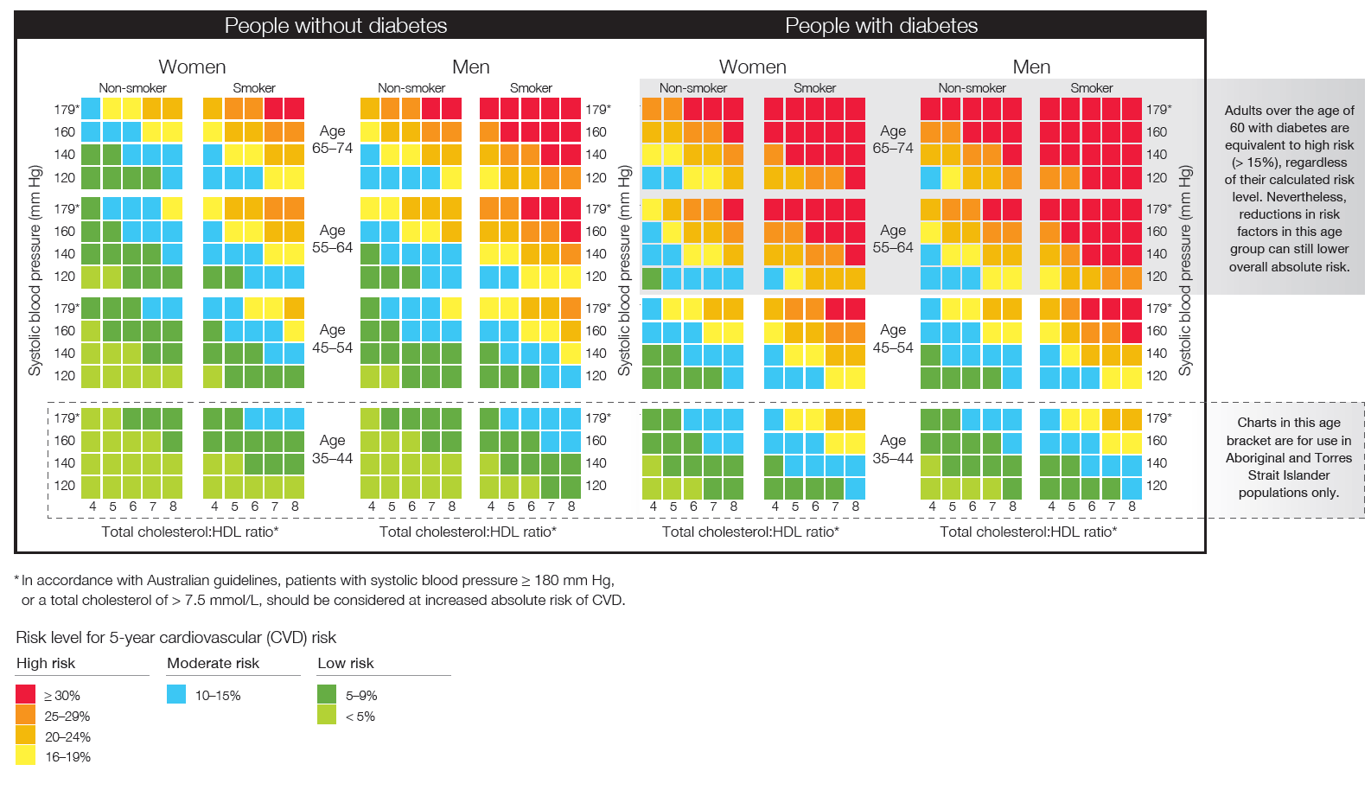
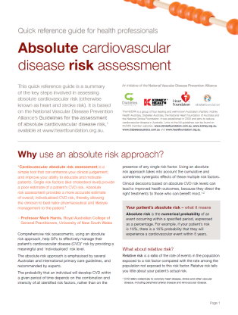
Adapted from (p. 4-5):
Demonstrate the use
Notes:
These are the charts in paper form. Ask the class, what is the critical information that we need for the calculator?
Diabetes
Sex
Smoking status
Age
Blood pressure
Total cholesterol to HDL ratio
Aboriginal or Torres Strait Islander person?

Slide 23
Online calculator
http://www.cvdcheck.org.au/
Demonstrate the use
Notes:
An online version of the calculator is also available. We will use it to look at Wendy and Greg!

Slide 24
Two patients
Wendy
Greg
Age 53
Ex-smoker for 7 years
2-3 standard drinks/day
BP 165/95
2 serves of fruit a day
BMI = 30
Total chol = 7.0 mmol/l
HDL = 1.4 mmol/l
No diabetes
Age 65
Non smoker
2 standard drinks/day
BP 145/92
10 min of exercise a day
BMI = 25
Total chol = 5.6mmol/l
HDL = 0.7 mmol/l
No diabetes
Demonstrate the use
Notes:
Let’s revisit Wendy and Greg.
Wendy’s risk → 7% (online calc) or 5-9% (paper calc)
Greg’s risk → 20% (online calc) or 20-24% (paper calc)
Wendy is actually at “low risk”, while Greg is at “high risk”.
In fact, he is at around three times the risk of Wendy. Importantly, other the influences of factors like their differences in weight and exercise will not even come close to bridging this difference in risk.
Get the students to reflect on this (most student groups tend to rate Wendy to have been the person at higher risk). What is the message? It is easy to be mislead by single risk factors. Remember again one of the messages – we often underestimate high risk (Greg – most students wouldn’t have wanted to give him pharmacotherapy) and overestimate low risk (Wendy – many students would have wanted to treat her right away with drugs).

Slide 25
Management strategy – low risk
Adapted from (p. 5):
Lifestyle Pharmacotherapy Monitoring
Describe the management
Notes:
Now this is a generic guideline and in real life, you need to contextualise and individualise care. Nevertheless, this is an excellent start.
For people like Wendy who are at low risk, the mainstay of therapy is lifestyle interventions address SNAP risk factors (smoking, nutrition, alcohol and physical activity). Pharmacotherapy would not be routinely recommended, certainly, not initially. As a rule of thumb, it would be reasonable to monitor the patient every 3 months or so, and if target levels are not achieved with blood pressure, it may be reasonable to start an anti-hypertensive agent after 6-12 months. The NHF Hypertension guidelines suggest that for people with low CVD absolute risk, it would be reasonable to start an anti-HTN if systolic BP consistently remains > 150 or diastolic BP remains > 90. The CVD Absolute Risk management guidelines (above) are a little more generous with BP.
In general, lipid lower medications are not warranted in this group.
In general, there is little to be gained in frequent repeating of blood tests in this group – probably not necessary to do so any more frequently than every 2 years.

Slide 26
Management strategy – high risk
Adapted from (p. 5):
Lifestyle Pharmacotherapy Monitoring
Describe the management
Notes:
For people at high risk, they need aggressive management of their risk factors. This requires substantial negotiation and counselling as Greg might otherwise feel entirely well!
Lifestyle interventions still play a major role and need to be emphasised.
For people at high CVD absolute risk, the recommendation is immediate pharmacotherapy to lower BP and lipids (unless there is a good reason not to).
Follow up thus is necessarily more frequent in monitoring the effects of medication.
It is important to treat to targets – whether this is achieved through lifestyle and/or medications. Those who make major changes to lifestyle can often use lower doses of medication, or potentially withdraw from medications altogether. Again, the important point is to treat to target.

Slide 27
Overview
Intensity of intervention determined by CVD absolute risk
High risk = aggressive lifestyle interventions + immediate drug therapy
Trial of lifestyle interventions prior to drugs for moderate and low risk
Know your targets and follow up.
Describe the management
Notes:
Now, this is the overall tablet that also includes “moderate risk”.
Rules of thumb:
High risk = aggressive lowering of risk factors → immediate drug treatment for BP and lipids to get to target.
Moderate and low risk = trial of lifestyle interventions first → if insufficient response, consider drugs for BP. Could consider drugs for lipids but not routinely.

Slide 28
Learning objectives
Explain the benefits of absolute CVD risk assessment
Identify the information required to use the CVD risk charts and calculator
Demonstrate the use of the CVD risk assessment tools
Describe the management of a patient’s cardiovascular risk according to best practice guidelines
Any questions?
Notes:
Any questions?

Slide 29
References
http://www.heartfoundation.org.au/information-for-professionals/Clinical-Information/Pages/absolute-risk.aspx
National Vascular Disease Prevention Alliance. Guidelines for the assessment of absolute cardiovascular disease risk. 2009.
National Vascular Disease Prevention Alliance. Quick reference guide for health professionals - Absolute cardiovascular disease risk assessment. 2009.
National Vascular Disease Prevention Alliance. Technical report: review of the evidence and evidence-based recommendations for practice. 2009.
National Vascular Disease Prevention Alliance. Guidelines for the management of absolute cardiovascular disease risk. 2012.
National Vascular Disease Prevention Alliance. Quick reference guide for health professionals - Absolute cardiovascular disease risk management. 2012.
Notes:
All documents available from the Heart Foundation website. The bolded references are key – students can be examined on the content of these references.

